Slide 1
Drug-Induced Homicide
MCAS

Slide 2


Slide 3
What is Opioid?
Opioids are a class of drugs created either directly from the Opium Poppy plant, or made in a lab using the same chemical structure
Opioids are commonly used as medication to relieve pain or anxiety
Some types of opioids:
Codeine
Morphine
Opium
Heroin

Slide 4
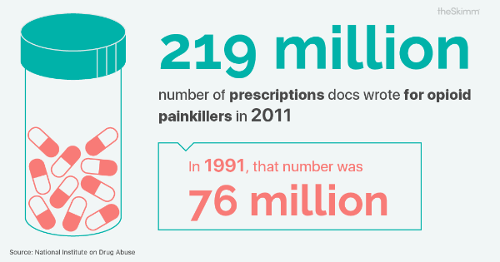

Slide 5
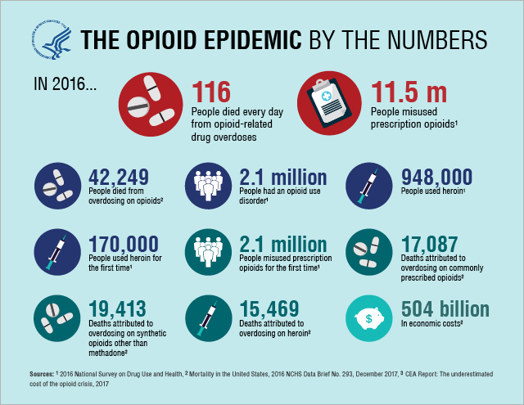

Slide 6
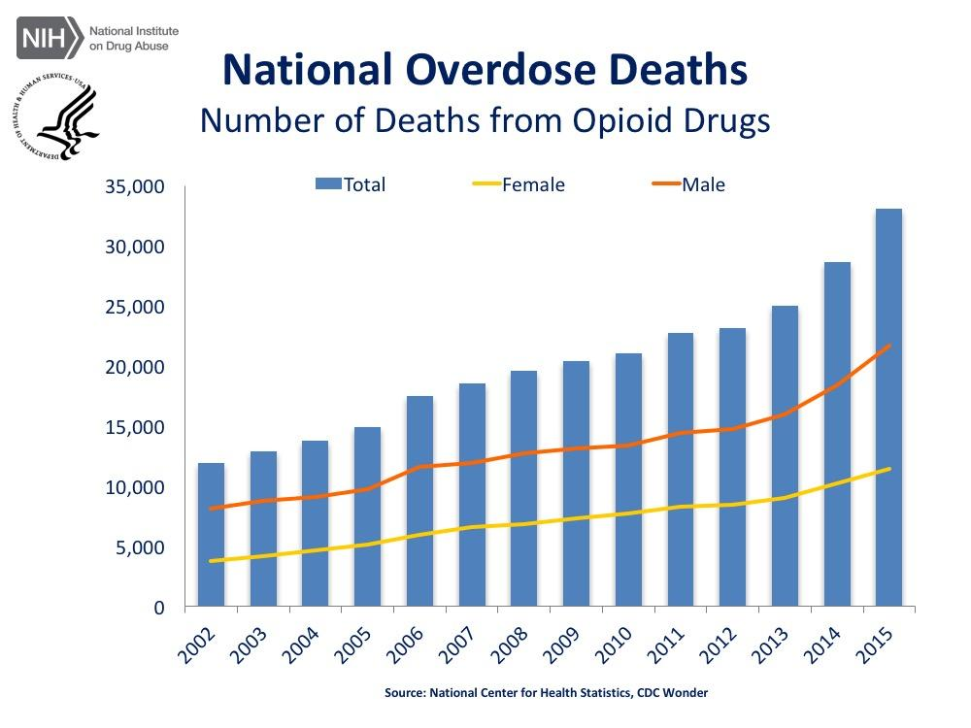

Slide 7


Slide 8
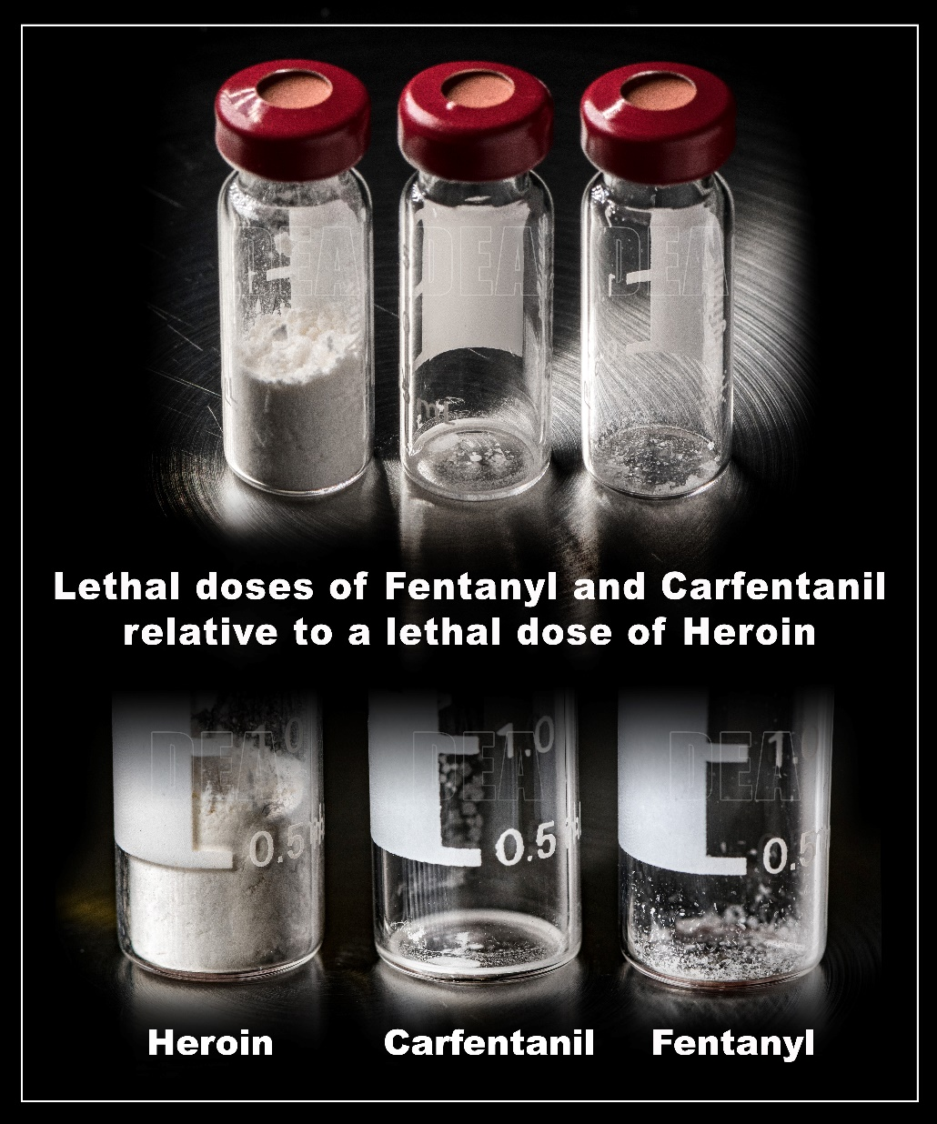
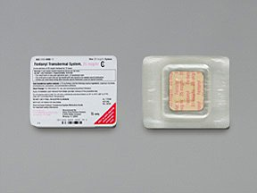

Slide 9
Drug-Induced Homicide
Illinois Statute:
A person who violates Section 401 of the Illinois Controlled Substances Act or Section 55 of the Methamphetamine Control and Community Protection Act by unlawfully delivering a controlled substance to another, and any person’s death is caused by the injection, inhalation, absorption, or ingestion of any amount of that controlled substance, commits the offense of drug-induced homicide.
Illinois Statute CSA 401:
. . . it is unlawful for any person knowingly to manufacture or deliver, or possess with intent to manufacture or deliver, a controlled substance. . . .
be sentenced to a term of imprisonment of not less than 15 years and not more than 30 years

Slide 10
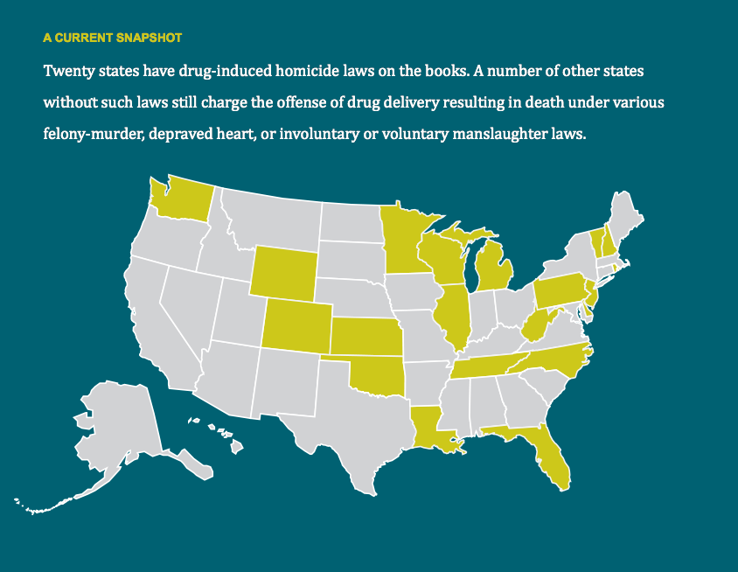

Slide 11
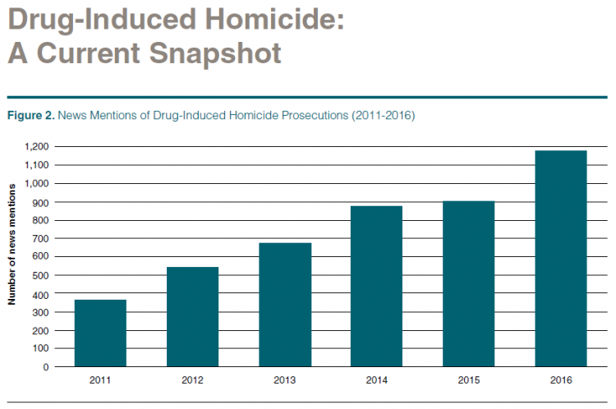

Slide 12
On August 10, 2014, Amy Shemberger did what people who use drugs do every day – she took a ride to score heroin for herself and her boyfriend, Peter Kucinski. On the ride home, Amy snorted one of the bags of heroin. When she got back, Peter asked for his portion. He was having severe alcohol withdrawal and needed the heroin to feel better.
After snorting a $10 bag of heroin, Peter stopped breathing and Amy called 911.
Amy was convicted and serving a seven year sentence

Slide 13
A 2002 analysis of 32 drug-induced homicide prosecutions, published in the New Jersey Law Journal, found that "25 involved prosecution of friends of the decedent who did not sell drugs in any significant manner."
According to a 2017 report by a Wisconsin TV station that looked at the 100 most recent prosecutions for drug-induced homicide in that state, "nearly 90% of those charged were friends or relatives of the person who died, or the lowest people in the drug supply chain."
When the Chicago Tribune examined drug-induced homicide cases filed between 2011 and 2014, it found "the defendant was typically the last person who was with the person who overdosed."

Slide 14
http://www.businessinsider.com/drug-induced-homicide-policies-overdose-heroin-2016-10

